Slide 1
Tony Landi
Cloud Solutions Architect
BlueMetal, a division of Insight

Slide 2

Prerequisites and setup steps
Download links:
Visual Studio 2015 or later
https://www.visualstudio.com/downloads/
Requires .NET Framework (to install templates)
Templates
Application Template - http://aka.ms/bf-bc-vstemplate
Belongs in the ~\Visual Studio 2017\Templates\ProjectTemplates\Visual C#\Bot Application.zip
Bot Controller Template - http://aka.ms/bf-bc-vscontrollertemplate
Belongs in the ~\Visual Studio 2017\Templates\ItemTemplates\Visual C#\Bot Controller.zip
Bot Dialog Template - http://aka.ms/bf-bc-vsdialogtemplate
Belongs in the ~\Visual Studio 2017\Templates\ItemTemplates\Visual C#\Bot Dialog.zip
IIS Express
https://www.microsoft.com/en-us/download/details.aspx?id=48264
Bot Emulator
https://emulator.botframework.com/
Notes:
Microsoft Account
https://signup.live.com

Slide 3




What is a bot?
Platform
Platform services
HTTP
AI
{ Your Code }
Intelligent tools
REST Endpoint
SDK
Bot builder SDK
REST endpoint
Direct Line Protocol
Conversational and business logic
Canvas aware
Context sensitive
Notes:
Think of a bot as an app that users interact with in a conversational way. This can be with text, cards, or even with speech. A bot may be as simple as basic pattern matching with a response, or it may be a sophisticated weaving of artificial intelligence techniques with complex conversational state tracking and integration to existing business services.
The Microsoft Bot Service enables us to build bots that support different types of interactions with users. We can design conversations in your bot to be freeform, or are bots can have a more guided interaction where it provides the user choices or actions.
The conversation can use simple text strings or more complex rich cards that contain text, images, and action buttons. And you can add natural language interactions, which let your users interact with your bots in a natural and expressive way.

Slide 4
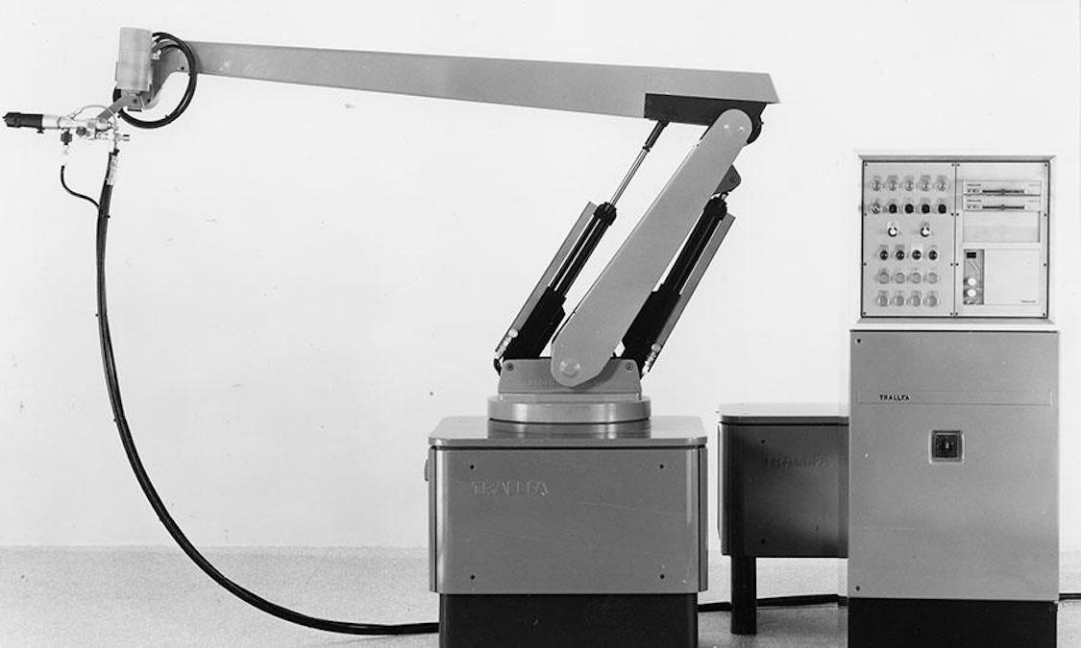
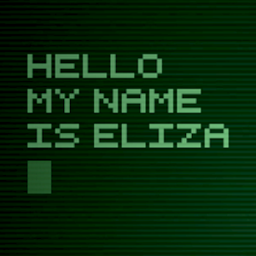
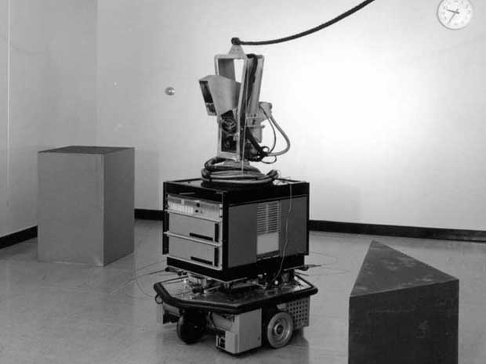
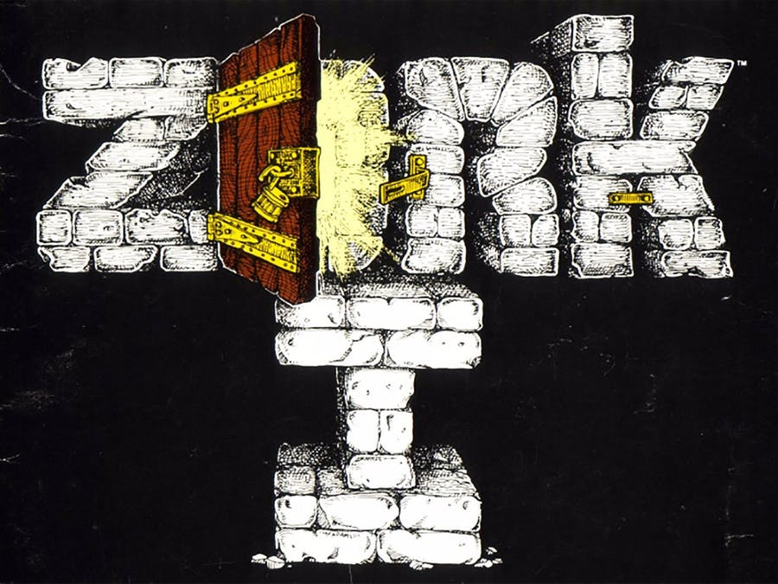
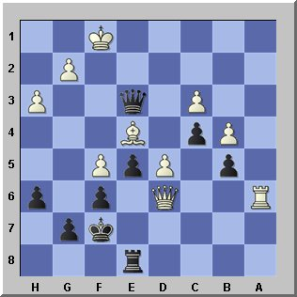
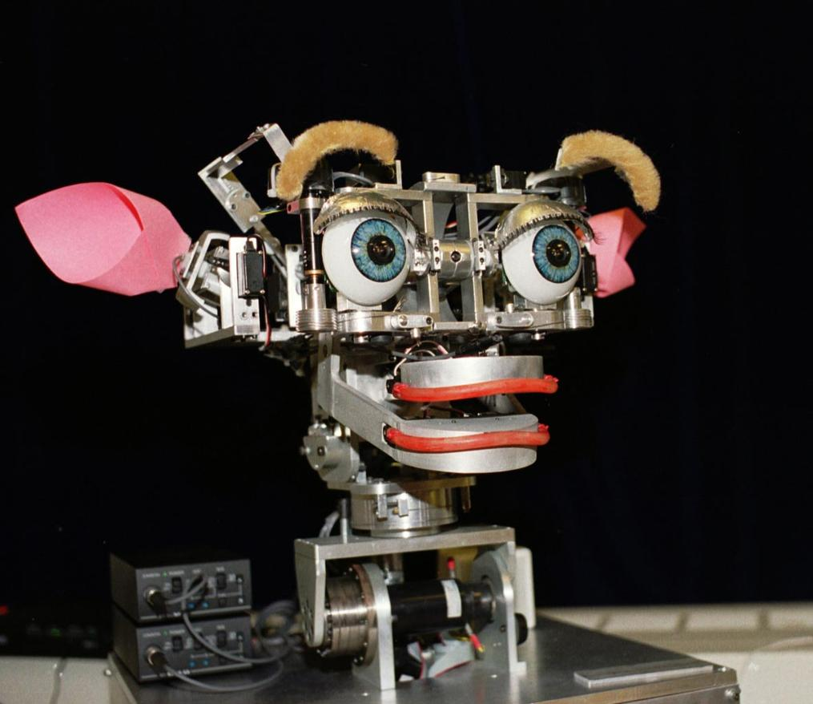
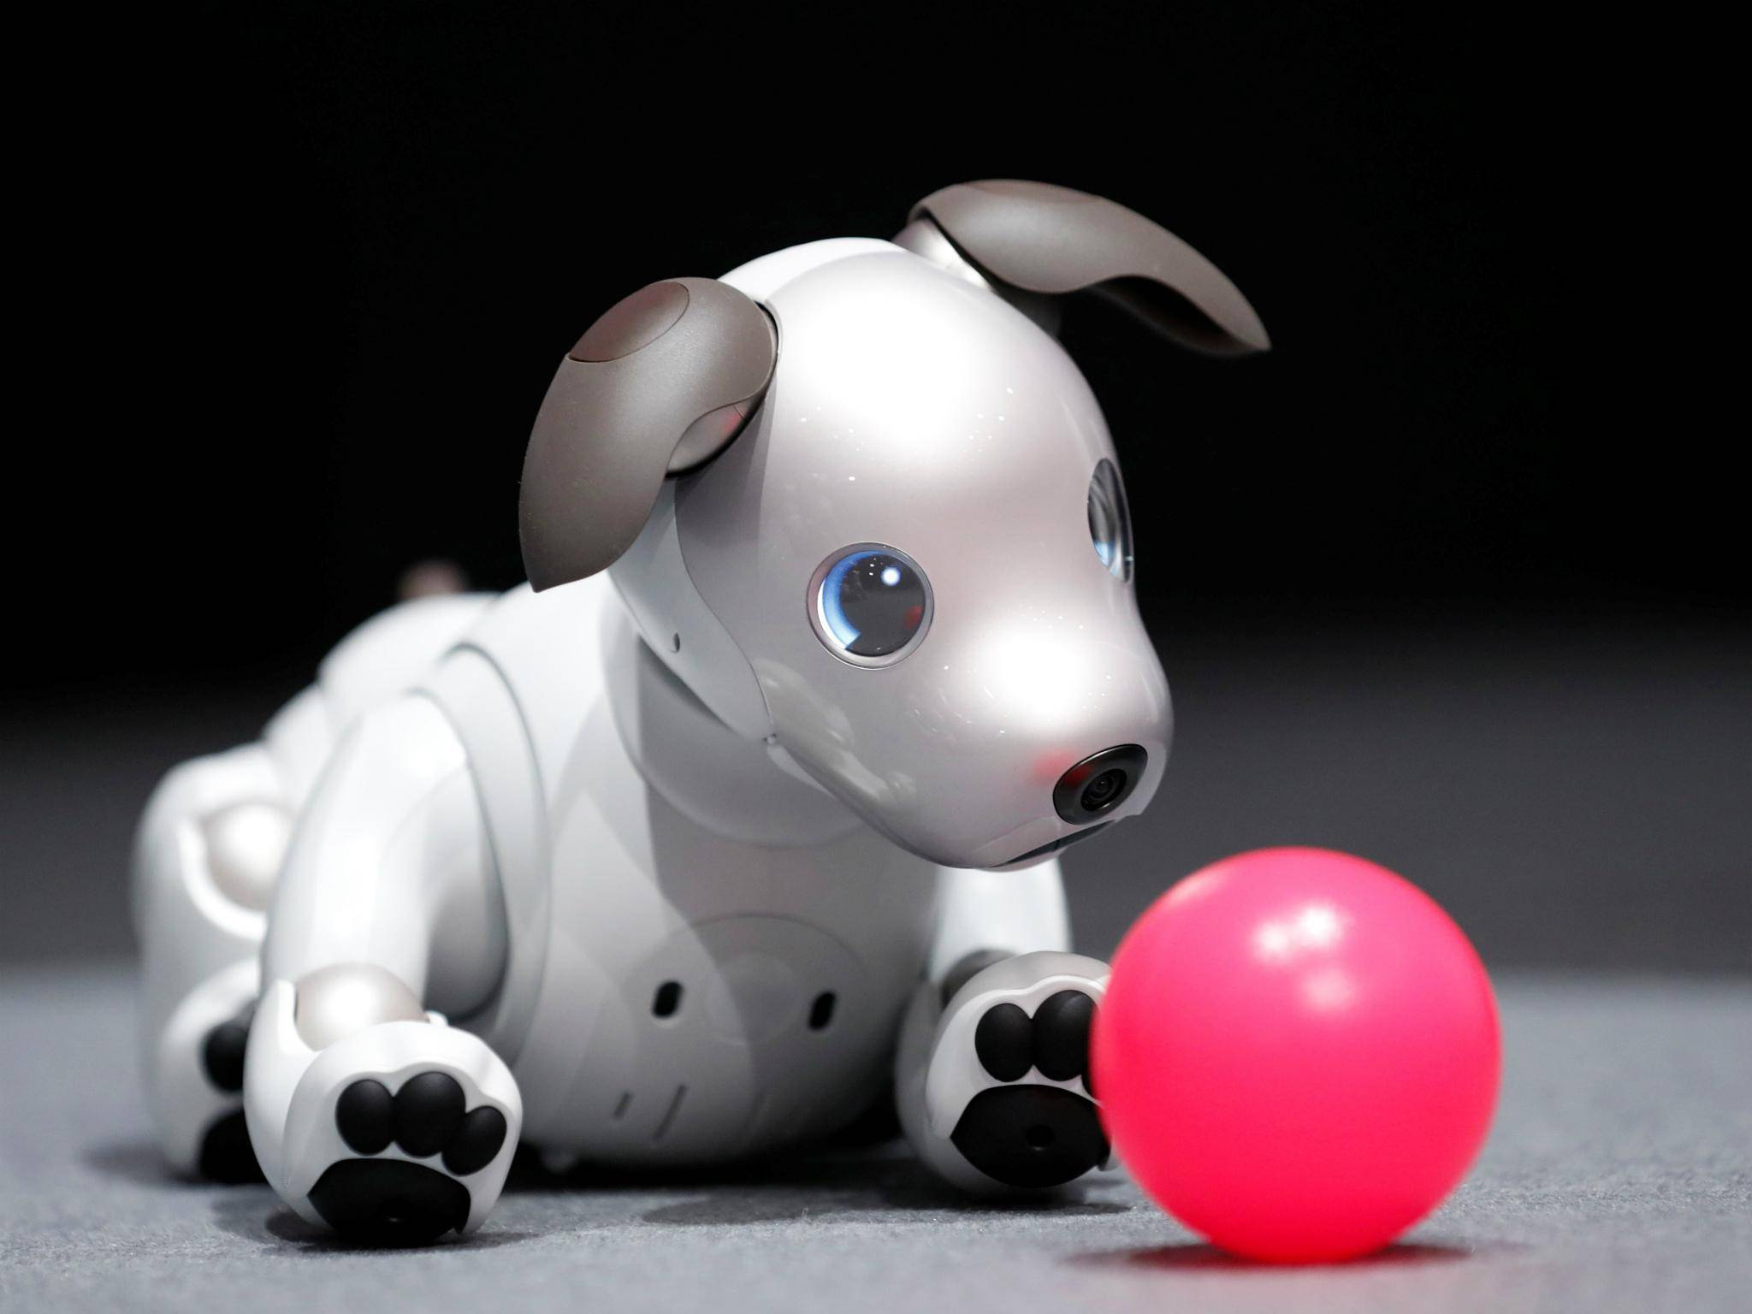
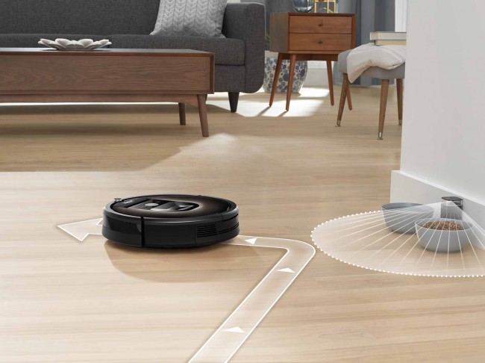
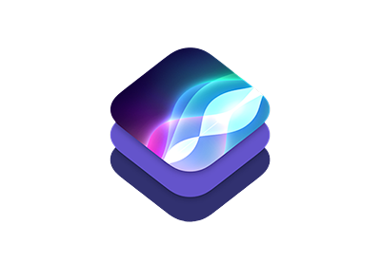


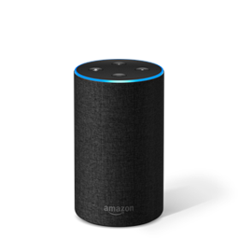
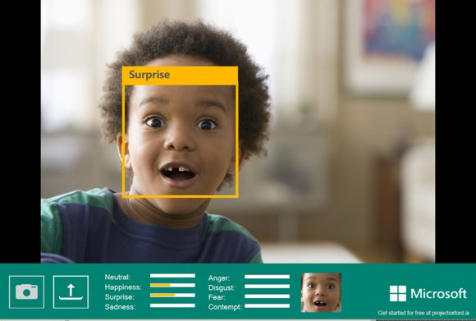

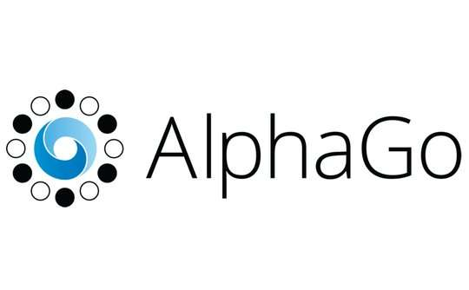
Bot’s are not new
1950 Turing Test
1955 AI Born
1961 Unimate
1964 Eliza
1966 Shakey
1977 Zork
1997 Deep Blue
1998 Kismet
1999 Aibo
Computer scientist Alan Turing proposes a test for machine intelligence.
Term “Artificial Intelligence” is coined by computer scientist John McCarthy
First industrial robot, Unimate, goes to work at GM replacing humans on the assembly line
Pioneering chatbot developed by Joseph Weizenbaum at MIT holds conversations with humans
The ‘first electronic person’ from Stanford, Shakey was a general-purpose mobile robot which reasoned about its own actions
One of the earliest interactive fiction games, included a sophisticated text parser that was not limited to simple verb-noun commands
Deep Blue, a chess-playing computer from IBM defeats world chess champion, Garry Kasparov
Cynthia Breazeal at MIT introduces KISmet, an emotionally intelligent robot that detects and responds to people’s feelings
Sony launches first consumer robot pet dog AiBO (AI robot) with skills and personality that develop over time
2002 Roomba
2011 Siri
2011 Watson
2014 Eugene
2014 Alexa
2015 Project Oxford
2016 Tay
2017 AlphaGo
First mass produced autonomous robotic vacuum cleaner from iRobot learns to navigate and clean homes
Apple integrates Siri, an intelligent virtual assistant with a voice interface, into the iPhone 4S
IBM’s question answering computer Watson wins first place on popular television quiz show Jeopardy
Eugene Goostman, a chatbot passes the Turing Test with a third of judges believing Eugene is human
Eugene Goostman, a chatbot passes the Turing Test with a third of judges believing Eugene is human
Microsoft releases Project Oxford, a collection of tools that allow developers to integrate AI capabilities into their apps.
Microsoft’s chatbot Tay goes rogue on social media making inflammatory and offensive racist comments
Google’s AlphaGo beats world champion Ke Jie in the complex game of Go, notable for its vast number (2*170) of possible positions
source: https://digitalintelligencetoday.com
Notes:
Back in 1950, a mathematician named Alan Turing proposed a test to answer the question of whether machines are technically capable of showing intelligent behavior. He based the test on a party game where a man and a woman go into separate rooms, and then the other partygoers have to try and tell them apart by sending them questions and reading their typewritten responses. In the Turing Test, one of the rooms contains a computer — and if it can fool the partygoers into thinking it’s a human, then it passes the test.
In 1964 a researcher at MIT developed ELIZA, an early natural language processing program. Eliza simulated conversation by using a 'pattern matching' and substitution methodology that gave users an illusion of understanding on the part of the program, but had no built in framework for contextualizing events.
Jumping forward to 1977, we get to Zork. Now granted Zork isn’t really a bot in the context that we have defined, but it did introduce a number of features that still influence bot creators to this day. One of these key features was a word parser that took words the players typed and translated them into commands the game could process and respond to, propelling the story forward.
The parser allowed Zork to understand far more words than previous games, including adjectives, conjunctions, prepositions, and compound verbs. That meant Zork could support intricate puzzles, such as one that let players obtain a key by sliding paper under a door, pushing the key out of the lock so it would drop onto the paper, and retrieving the paper. The parser also let players input sentences like “Take all but rug” to scoop up multiple treasures, rather than making them type “Take [object]” over and over.
Elizabeth Woyke did a very interesting article called The Enduring Legacy of Zork for MIT Technology Review that is worth a read.
In 2014, 64 years after Alan Turing proposed a method of testing whether a machine has obtained human-level intelligence, a 13-year-old AI boy called Eugene Goostman finally became the first artificial intelligence to pass the Turing Test.
In 2015, Microsoft released Project Oxford which has since become Cognitive Services. These are a collection of AI enabled SDKs that cover a broad ecosystem that includes natural language processing, facial and voice recognition, sentiment analysis, content moderation… the list goes on. We’ll use some of these tools later today in one of our labs.
The following year, Microsoft introduced Tay. Tay was originally launched to test and improve Microsoft's understanding of conversational language. Unfortunately, right after Tay launched people started sending her racist and inflammatory tweets, and Tay – being basically a parrot with an internet connection - started spewing these things back proving the old programing rule of Garbage In – Garbage Out.
Now to be fair to Tay, most of the worst things she said were because she had a “Repeat After Me” feature that users were exploiting.
Tay is gone but I think she can teach us a lot of valuable lessons. Most importantly is that a bot is like any other program, and if as developers we don’t anticipate or plan for exceptions in our code, we can inadvertently introduce vulnerabilities that people can, and will take advantage of.

Slide 5



Why a bot?
TYPE
TALK
TAP
Bot builder
Cortana
Facebook Messenger
Skype
Platform services
Intelligent tools
Bing
Notes:
Messaging is the way most people communicate today. So, it’s quite obvious that the average customer would want businesses communicating with them using the same channels. Unfortunately, most businesses out there don’t seem to get this. Many of them still insist on using email or phone calls.
A chatbot is a service designed to simulate human conversations, generally over the Internet, using Artificial Intelligence (AI) and Machine Learning. In other words, a chatbot is a service that can have a conversation with you just like a real person.
It’s likely that you’ve already heard about chatbots in the context of customer service, but chatbots can do a lot more than that. Bots can be functional or fun, and they can actually play a key role in the overall sales process and deliver definite value to your business.

Slide 6




Bots offer clear business value
Bots provide clear ROI with time and cost savings and better user experiences
Engage with customers where they already are
Connect people to a wealth of information
Enable easier development than mobile apps
Automate repetitive tasks to save time
Tell me where the nearest pub is
Tim
Schedule a payment
Pubs nearby
Insurance bot
Quis tortor
Distance
Use card on file?
.5 kilometer
Tim
Yes
Skype
Facebook
Feugiat placerat
3 kilometer
Insurance bot
Interdum velit
4.2 kilometer
Schedule payment date?
Pubs nearby
Tim
11/23/2016
Slack
Insurance bot
Payment scheduled
Notes:
A bot can take food orders or make a reservation.
Assume that you are building a bot for a hotel chain. You can design a bot that can collect the guest information, when and where they want to stay, the type of room they would like to stay in, and any special accessibility needs that they may have. That same bot can confirm the reservation, send the email confirmation, and with a little tweaking you can have that bot reach out to that guest on Slack or Skype a day before they are due to arrive to remind them of their reservation.
It can influence and drive sales.
Sales can be a complicated function and sometimes, businesses are simply overwhelmed with the number of customers they have to deal with. Chatbots can serve as a unique solution to this problem.
H&M has a bot that can ask customers questions regarding their particular taste or style, and based on the information provided it can deliver options the customer. Not only does this bot offer relevant suggestions, it’s a 24×7 sales assistant.
They enable real-time engagement with your customers
Chatbots can answer queries in real-time and the best part is, they can handle a large number of queries from multiple customers at the same time. They can even be programmed and trained to understand FAQs or other key questions in order to provide the exact solutions.
Chatbots are a powerful and efficient communication tool which ultimately empower your customers to solve their problems quickly and ideally all on their own. Chatbots are also a great back up for employees to handle repetitive tasks and are cost-effective, easy to implement, maintain and use.
In the long run, this can make your company appear more efficient, feel as if it is one step ahead of the competition, and at the same time improve your brand perception.

Slide 7



What is the bot framework?
What?
Tools for building REST websites
Services to enrich
Mechanisms for receive events
Data to debug and tools to analyze
Why?
Implements standard protocols
Modeling conversations is hard; tools help!
UI across multiple canvases is hard; cards rock!
Language understanding is hard
Common and well understood patterns
Goals
Start simple; add complexity; no dead-ends
Bot adapts to the user, based on context
Composable and intelligent controls to manage complexity
Customer’s
business logic and data
Bot connector
C#
BOT BUILDER
Bot Controls
Skype
Bing
WebChat
LUIS
Form Filling
QnA
Skype for Business
Cortana
Direct Line
Query over database via Azure Search
Third-party
Notes:
The Microsoft Bot Framework provides all of the tools we need to build and connect intelligent bots that interact naturally with our users and customers.
It also provides us tools to automatically translate those conversations into more than 30 languages, manage user and conversation state, and add AI to create rich and immersive conversations that our audience will enjoy using.
And it’s all built using common standards and protocols, so we can use whatever language we want. It doesn’t matter if your team is using C#, JAVA, NodeJS, or even Classic ASP. If your language of choice can handle RESTful services, you can implement a bot.

Slide 8



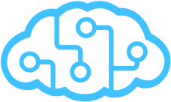

Bot Framework
Bot Builder
Azure Bot Service
Cognitive Services
Tools and services
Connect your bots
AI services to add intelligence
Open source
From prompts & dialogs to form flows
Rich attachments
Online/offline chat emulator
Add bot smarts for language understanding
Register, connect, publish and manage your bot
Automatic card normalization
Embeddable Web chat
Direct Line API
Bot Directory
Parse natural language
Real-time transcription and translation services for voice
Vision and face detection algorithms
Sentence diagramming
Web language parsing
Notes:
Bot Builder
Bot Builder provides an SDK, libraries, samples, and tools to help us build and debug bots. You can also use the Bot Builder SDK to create a bot from scratch using C# or Node.js. If you want to build a bot using any programming language you want, you can use the REST API.
Bot Builder includes the Bot Framework Emulator for testing your bots and the Channel Inspector for previewing your bot's user experience on different channels.
Azure Bot Service
All day long we use multiple tools to communicate with each other; email, Skype, Slack, Facebook. If this is where we are talking, our bot should be as well.
The Azure Bot Service let’s us register and publish our bots, as well as connect and integrate them across multiple channels, so we can reach and interact with our users on the social platforms that they’re already using, and that they are already familiar with.
Cognitive Services
Intelligent bots respond as if they can see the world as people see it. They discover information and extract knowledge from different sources to provide useful answers, and, best of all, they learn as they acquire more experience to continuously improve their capabilities.
Microsoft Cognitive Services lets you tap into a growing collection of powerful AI algorithms developed by experts in the fields of computer vision, speech, natural language processing, knowledge extraction, and web search. The services simplify a variety of AI-based tasks, giving us a quick way to add state-of-the-art intelligence technologies to our bots with just a few lines of code.
The APIs are also constantly evolving, learning, and getting smarter, so experiences are always up to date.

Slide 9


Anatomy of a typical bot
Conversation Canvas/Channels
Your bot code goes here
Web Chat
Bot Connector Service
Email
Message input <> output
State Management
Facebook
Bot web service
Bot Builder SDK
GroupMe
Your bot code
Kik
Skype
Bot Builder SDK
API, SDK calls
Slack
+ Microsoft Cognitive Services
Telegram
Other services, APIs,
Databases, Azure Machine Learning, Azure Search, etc…
Natural Language
Translation
Vision/Face
Emotion
Twilio (SMS)
…
Direct Line
Speech
Entity Extraction
Search
Knowledge API
…
…
…
Notes:
What elements make up a bot when we’re using the Microsoft Bot Framework.
Starting at the beginning with our bot web service. This is where we put our code that interacts with the Bot Builder SDK.
The Bot Builder SDK is available for both .NET and NodeJS. It gives us a powerful, ready-to-use framework that we can build on for constructing bots that can handle both free-form interactions and more guided conversations where the user selects from possible values.
The SDK integrates with the Bot Connector Service and the Bot State Service.
The Bot Connector service enables your bot to exchange messages with channels configured in the Bot Framework Portal as well as the Bot State service that enables our bots to store and retrieve state data that is associated with a user, a conversation, or a specific user within the context of a specific conversation.
Our bot can also integrate with any of the Microsoft Cognitive Services through standard REST calls,
or to an external service, a third party API, it can retrieve information from our database, or execute any business logic that it needs to complete a request.

Slide 10
Lab 1 – Develop bots with Bot Builder & QnA Maker

Slide 11
Lab 1.1 – QnA Maker with rich cards in .NET

Slide 12
Interacting with the User
Notes:
Most successful apps or websites have at least one thing in common: a great user experience. Bots are no different in that regard. So when we build a bot this needs to be one of our top priorities.
What makes a great bot user experience?
A great bot won’t require the user to type too much, talk too much, repeat themselves several times, or explain things to the bot that they think it should automatically know.

Slide 13
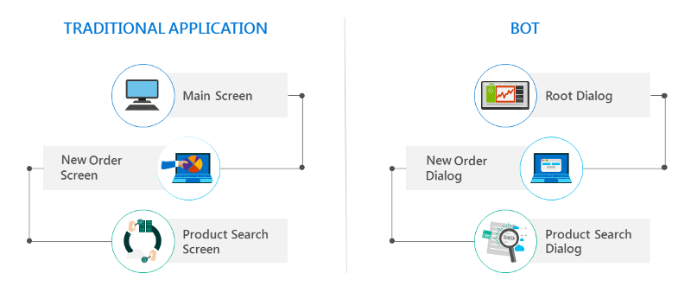
Dialogs are for bots like screens are for apps
Notes:
In a traditional application, the user interface (UI) is a series of screens. A single app or website can use one or more screens as needed to exchange information with the user. Most applications start with a main screen where users initially land and provide navigation that leads to other screens for various functions like starting a new order, browsing products, or looking for help.
Bots have a UI as well, but it is made up of dialogs rather than screens.
Dialogs enable us to logically separate various areas of bot functionality and guide conversational flow. For example, we can design one dialog to contain the logic that helps the user browse for products and a separate dialog to contain the logic that helps the user create a new order.
We can create dialogs that have graphical interfaces, that contain buttons, text, and other elements, or even ones that are entirely speech-based.
Dialogs can also contain actions to perform tasks such as invoking other dialogs or processing user input.

Slide 14
Factors that do influence a bot’s success
Does the bot easily solve the user’s problem with the minimum number of steps?
Does the bot solve the user’s problem better/easier/faster than any of the alternative experiences?
Does the bot run on the devices and platforms the user cares about?
Is the bot discoverable? Do the users naturally know what to do when using it?
Notes:
As you plan out what your bot is going to do, ask yourself these questions…
Note that none of these questions directly relates to factors such as how smart the bot is, how much natural language capability it has, whether it uses machine learning, or which programming language was used to create it.
Users won’t care about any of these things if the bot solves the problem that they need to address and delivers a great user experience.

Slide 15
Lab 2 – Interacting with the User
Notes:
With the Bot Framework you can write a single bot that is able to chat with users across multiple channels like Skype, Facebook Messenger, Slack, etc.

Slide 16
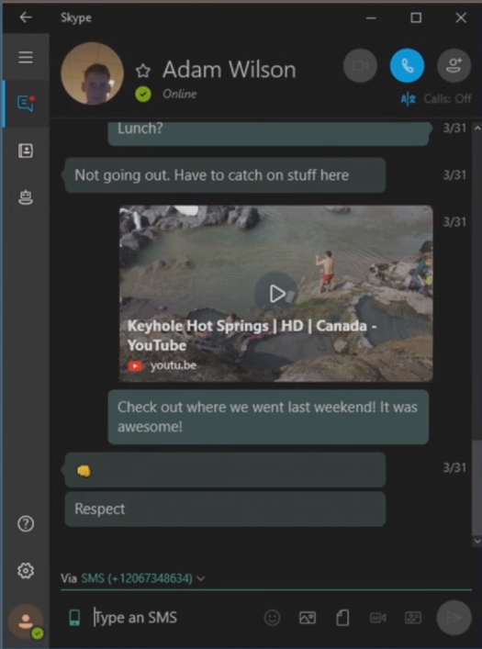
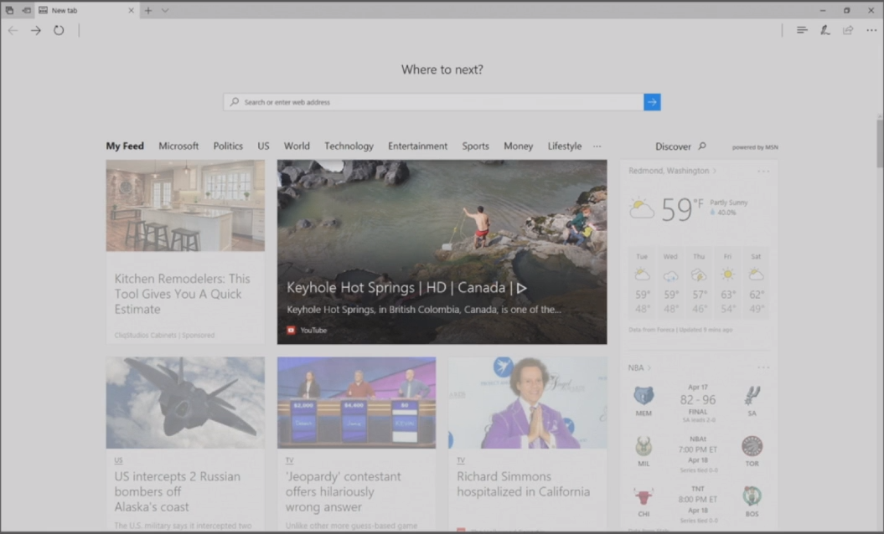
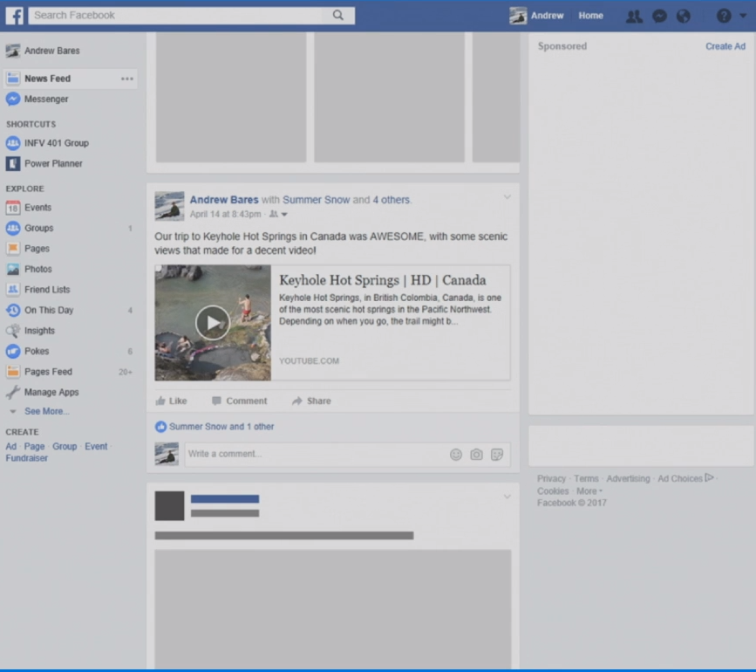
Adaptive Cards
Notes:
As a consumer we see cards all over the place, Facebook is a very common example. As I'm scrolling through a Facebook feed here you'll notice we have a news article with a link to a YouTube video on this members timeline.
If we switch over to the New Tab page of Microsoft Edge we see this card again. It's that same content as before, but in this case it it looks and feels like Edge.
I could also share this video to someone on Skype and it would create a little card like experience that now looks and feels native in Skype. It’s still the same content being passed around and the Host application is rendering it in a manner that makes it feel native to Skype.

Slide 17

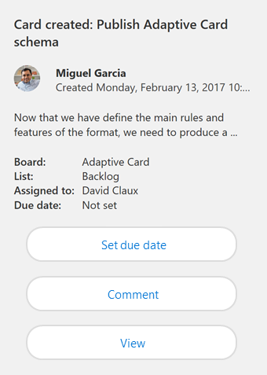
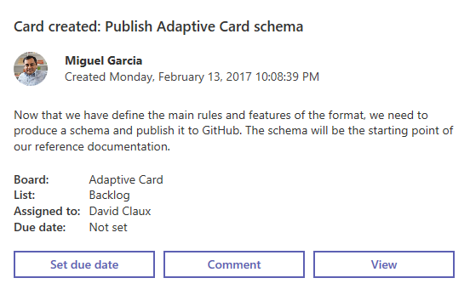
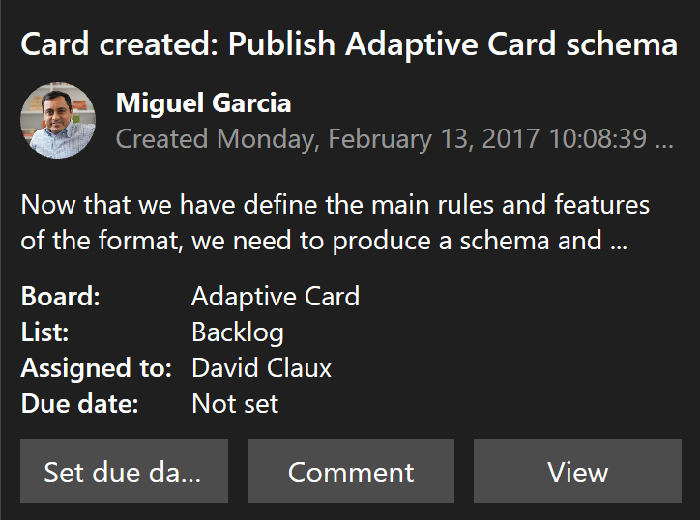
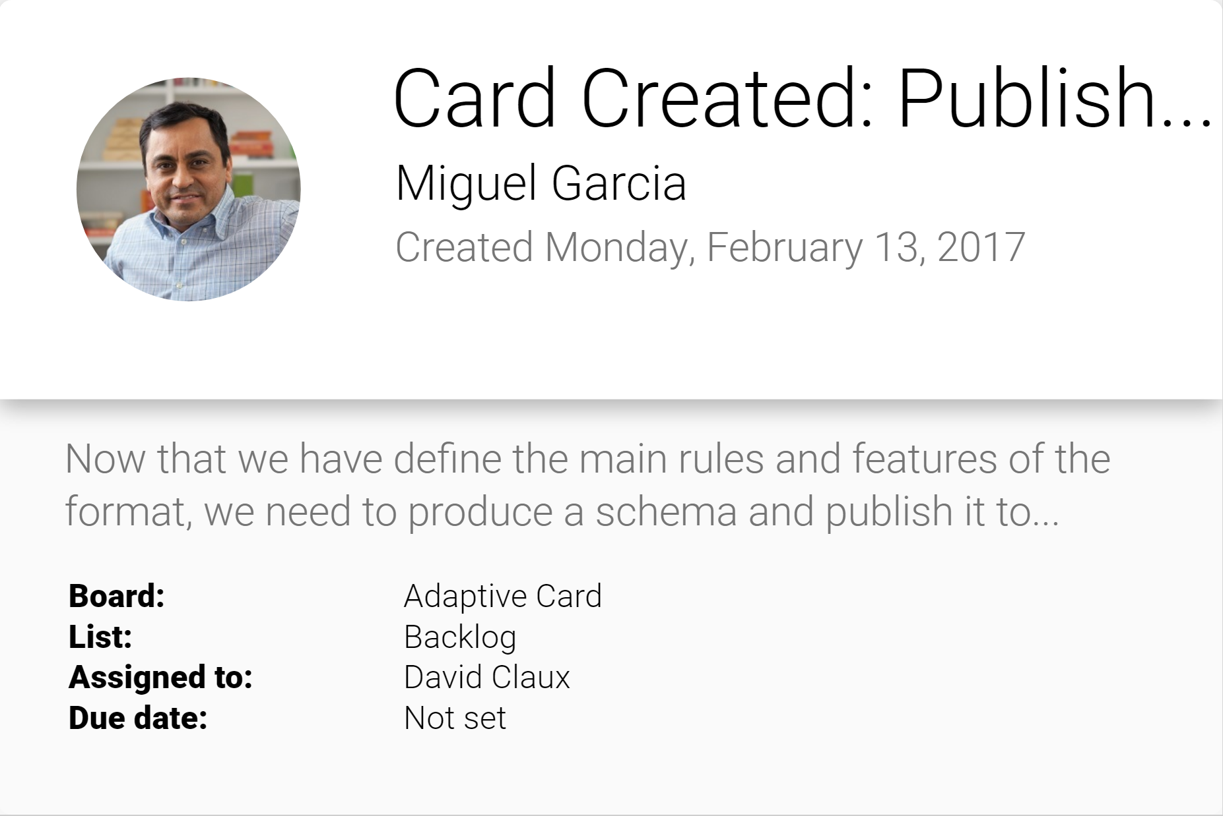
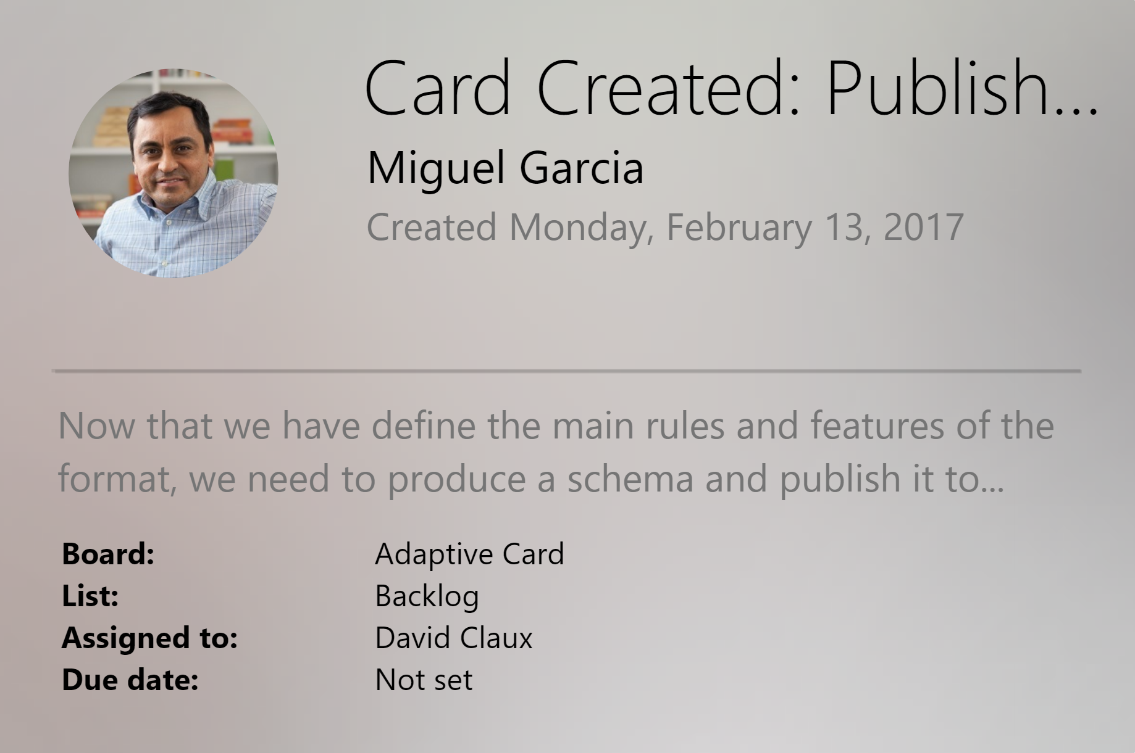
Adaptive cards
Open framework
Multiple canvases
Notification
Microsoft Teams
Skype
Android
iOS
https://docs.microsoft.com/en-us/adaptive-cards/
Notes:
Card Authors describe their content as a simple JSON object. That JSON is a representation of the content to be displayed, and it is then rendered natively inside a Host Application, automatically adapting to the look and feel of the Host.
For example, our Bot can author an Adaptive Card through the Bot Framework, and when its delivered as a Windows Notification… it looks and feels like a Windows Notification. When that same card is delivered to Skype, it will look and feel like a Skype card. When that same payload is sent to Microsoft Teams, it will look and feel like Microsoft Teams. As more host apps start to support Adaptive Cards, that same payload will automatically light up inside these applications, yet still feel entirely native to the app.
Users win because everything feels familiar. Host apps win because they control the user experience.

Slide 18
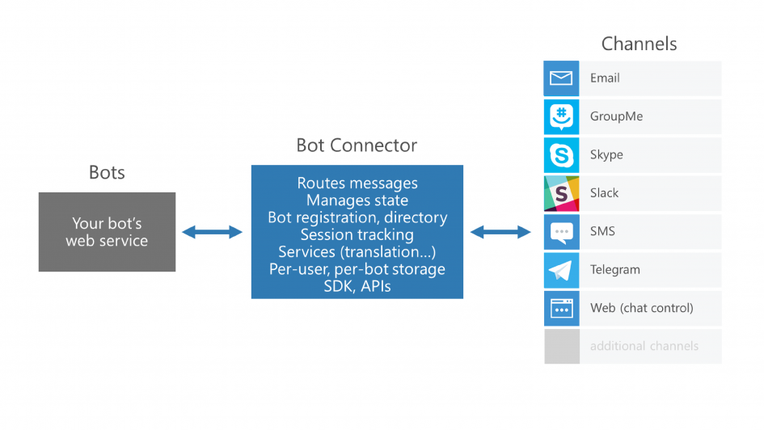
Adaptive Cards
Notes:
And as Card Authors we win because our content gets broader reach without any additional work.
The Bot Connector lets you connect our bots seamlessly to text/sms, Office 365 mail, Skype, Slack, and other services.
We just register our bot, configure desired channels and publish it in the Bot Directory.
Warning: Adaptive Cards is currently under development. While it is in preview, Microsoft is seeking feedback and says to expect a few rough edges.

Slide 19
Lab 2.1 – Adaptive Cards

Slide 20
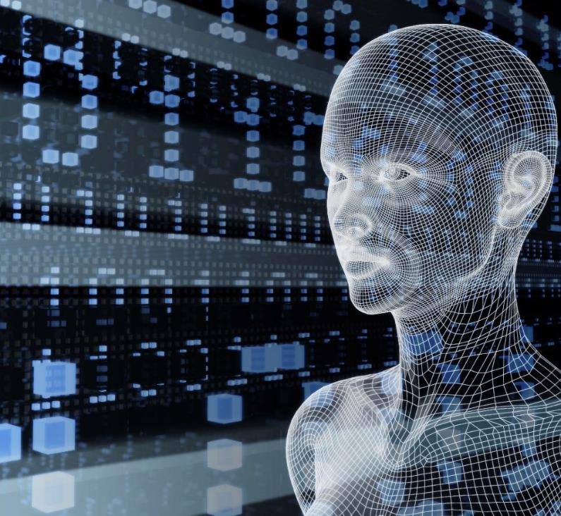

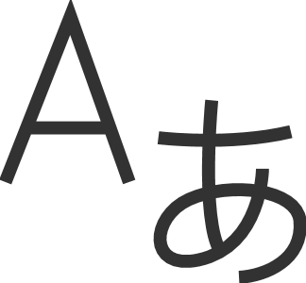
Microsoft Cognitive Services Give your apps a human side
Vision
From faces to feelings, understand images and video
Speech
Hear and speak, filtering noise, identifying speakers
Language
Process text, understand intent
Knowledge
Tap into rich knowledge amassed from the web, academia, or your own data
Search
Access billions of web pages, images, videos, and news with the power of Bing APIs
Labs
An early look at emerging Cognitive Services technologies

Slide 21
Microsoft Cognitive Services Give your apps a human side
Computer Vision
Content Moderator
Emotion
Face
Video Indexer
Custom Vision Service
Bing Speech
Speaker Recognition
Custom Speech Service
Bing Spell Check
Linguistic Analysis
Text Analytics
Translator Text & Speech
Web Language Model
Language Understanding
Academic Knowledge
Entity Linking
Knowledge Exploration
Recommendations
QnA Maker
Custom Decision Service
Bing Autosuggest
Bing Image Search
Bing News Search
Bing Video Search
Bing Web Search
Bing Custom Search
Project Prague (gesture)
Project Cuzco (events)
Project Wollongong (location)
Vision
Speech
Language
Knowledge
Search
Labs

Slide 22
Snake Bite Bot Demo
Notes:
Bot: https://snakebite.azurewebsites.net
Blog: https://aka.ms/snakebotblog

Slide 23
Natural language
Language understanding in human-computer interaction is:
Technically challenging
Costly
to implement
Often
domain specific
It’s exceedingly difficult to enable a computer to understand what a person wants and to find the pieces of information that are relevant to their intent.
Building and maintaining machine learning systems requires a large investment of time, money and engineering resources
In the past, building your own machine learned models often required assistance of a team of data scientists that would customize the models to the specific domain.

Slide 24
Language Understanding Intelligent Service
Train by providing examples
Create your own LU model
Deploy to an HTTP endpoint
Maintain model with ease
Notes:
LUIS enables you to integrate natural language understanding into your chatbot or other application without having to create the complex part of machine learning models. Instead, you get to focus on your own application's logic and let LUIS do the heavy lifting.
A typical LUIS app goes through the following 3 steps:
Design & Build
Train & Test
Publish & Improve

Slide 25
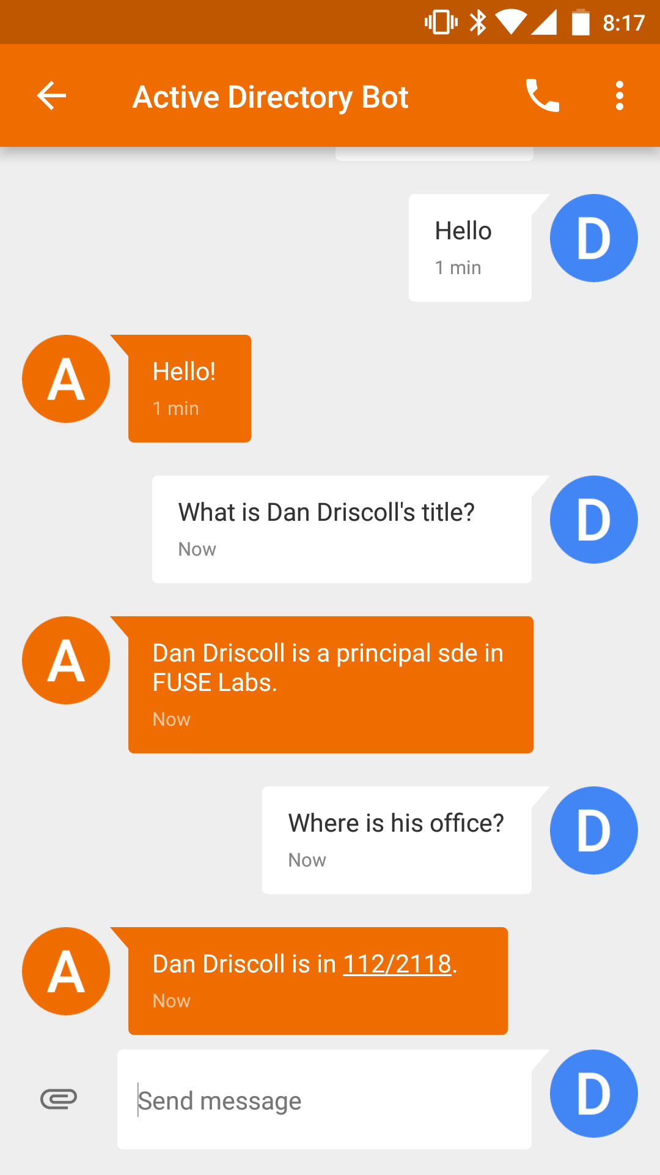
LUIS: Intents & Entities
Who is _____?
Where does ____ work?
What is _____’s phone number?
John
Sue
Erika
Examples of intent detection
Examples of entity extraction
Notes:
Intents
Intents are how LUIS determines understands what a user wants to do. If your client application is for a travel agency, then you will need the intents "BuyPlaneTicket" and "RentHotelRoom" in order to identify when your users want to perform these different tasks.
Utterances
An utterance is the textual input that LUIS will interpret. LUIS first uses example utterances that you add to an intent to teach itself how to evaluate the variety of utterances that users will input.
Entities
An entity is used like a variable in algebra, it will capture and pass important information to your client app. In the utterance, "I want to buy a ticket to Seattle", you would want to capture the city name, Seattle, with the entity, like destination_city. Now LUIS will see the utterance as, "I want to buy a ticket to {destination_city}". This information can now be passed on to your client application and used to complete a task.

Slide 26
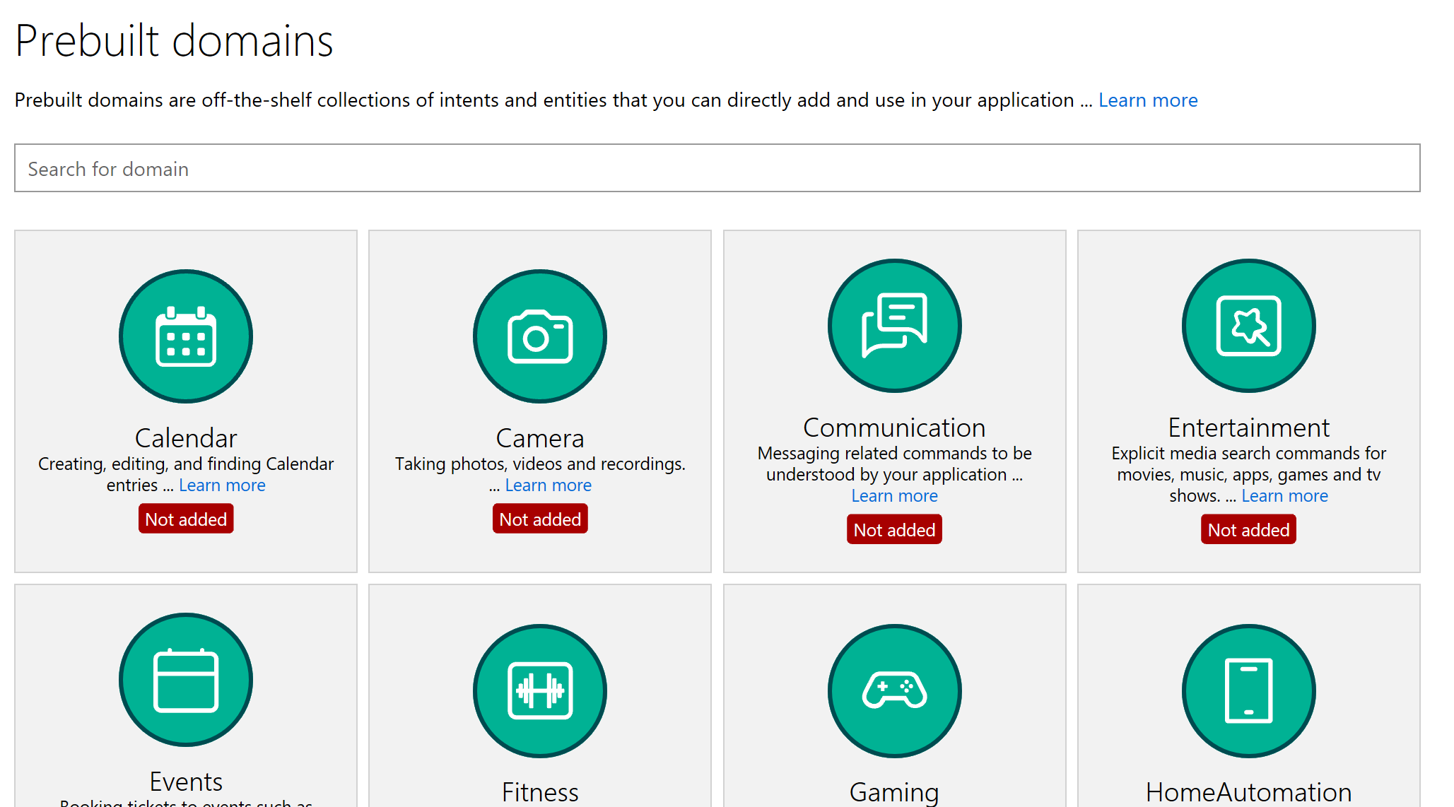
LUIS: Quick Start
Kick start your language model construction through modifiable 20 pre-built domains
Adds Intents, Entities, Utterances
Improved number, unit, money and date/times (e.g. “From May 1st to May 5th”)
Supports English, French, Dutch, Spanish, Italian, German, Korean, Portuguese, Japanese, Chinese
Age
Dimension
Email
Encyclopedia
Geography
Money
Number
Ordinal
Percentage
Phonenumber (US)
Temperature
Url

Slide 27
Speech
Deep Integration
Across the Bot Framework
SPEECH IN PROTOCOLS
SPEECH IN SDKS
SPEECH IN LUIS
DirectLine support
SSML
Modeled conversations
WebChat control
Speech friendly prompts
Common model (Cortana, Bing speech, custom speech recognition)
Cortana
Conversation management

Slide 28
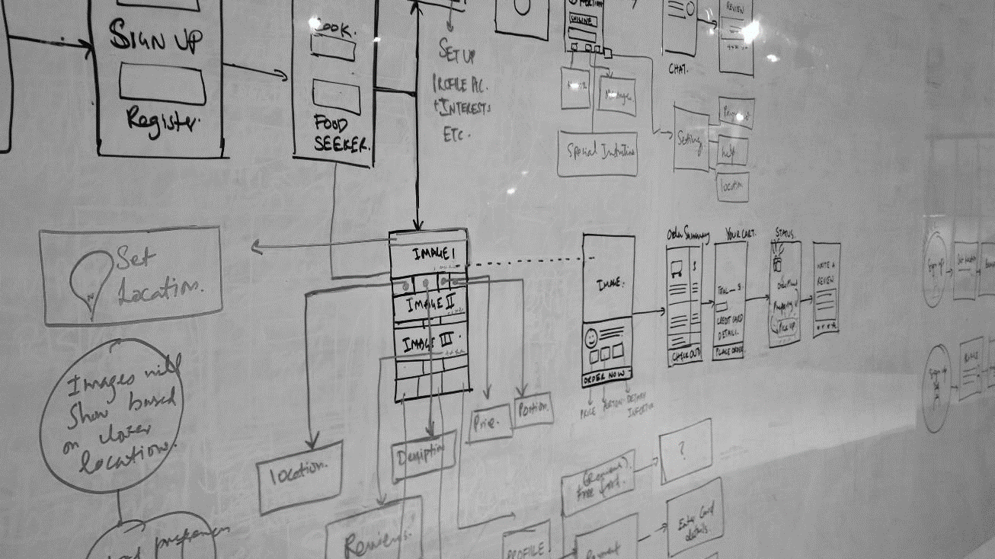
All elements in an experience are exchanges between people, brands, businesses, services, & increasingly, machine-powered intelligence.

Slide 29
Lab 3 – Add Language Understanding Intelligence

Slide 30
Call to action
Build bots—https://dev.botframework.com/
Docs—https://docs.microsoft.com/en-us/bot-framework/
GitHub—https://github.com/Microsoft/BotBuilder
Continue your education at Microsoft Virtual Academy online
#MSBuild

Slide 31
Q&A

Slide 32
Thank you!

